Slide 1
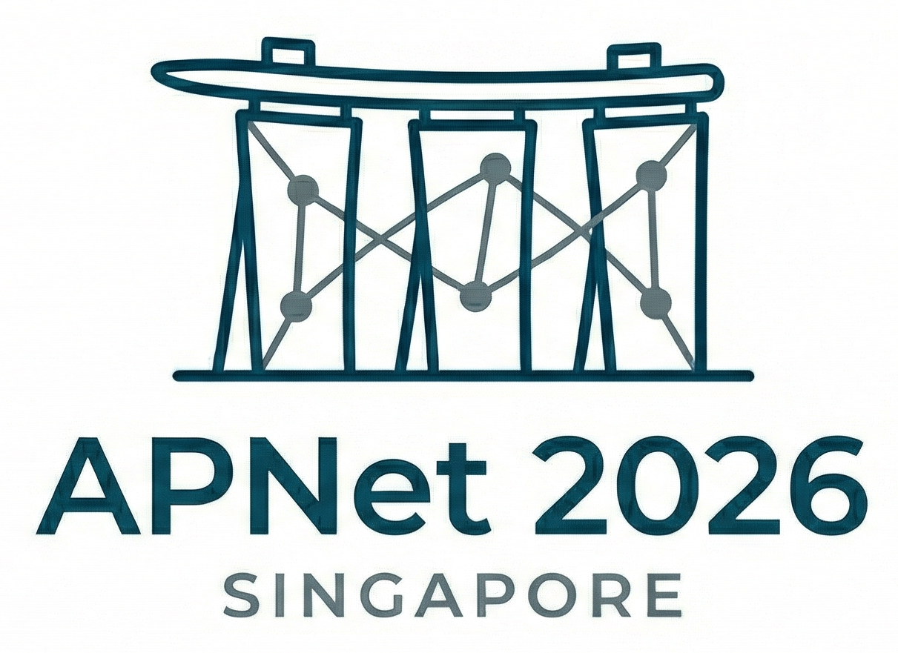
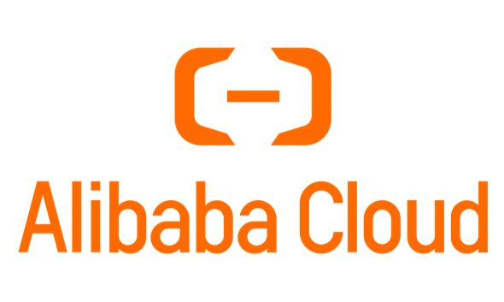




Integrating AI Clusters into Virtual Private Cloud
Yinhe Wang, Xing Li, Enge Song, Zihao Fan, Changgang Zheng, Haonan Li, Shengyao Gao, Juncheng Xiang, Ye Yang, Junnan Cai, Chang Liu, Haoxiang Pan, Yang Song, Yilong Lv, Qiang Fu, Zhigang Zong, Heng Pan, Shunmin Zhu
alibaba_cloud_network@alibaba-inc.com

Slide 2
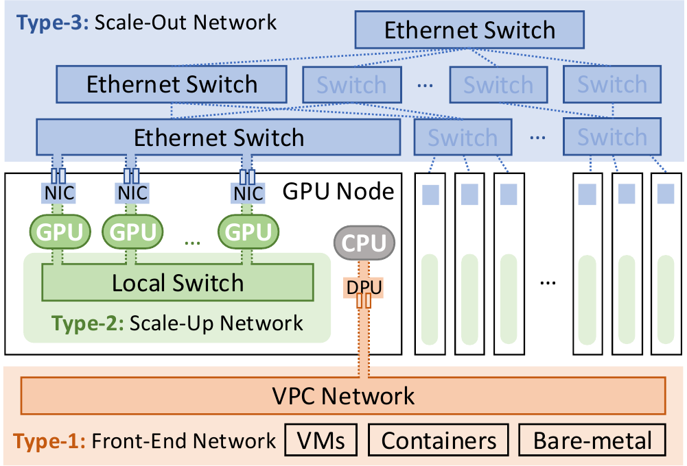
The network split creates a semantic gap
Front end
Connects the VPC and carries policy-rich traffic
hundreds of Gbps and ms-level latency
Uses DPUs -- powerful thanks to embedded CPU
Back end
Connects GPU nodes
Tb-scale bandwidth and ms-level latency
Uses commodity NICs -- cannot hold or execute the full VPC policy engine
Result
performance lives on one side
VPC semantics live on the other

Slide 3
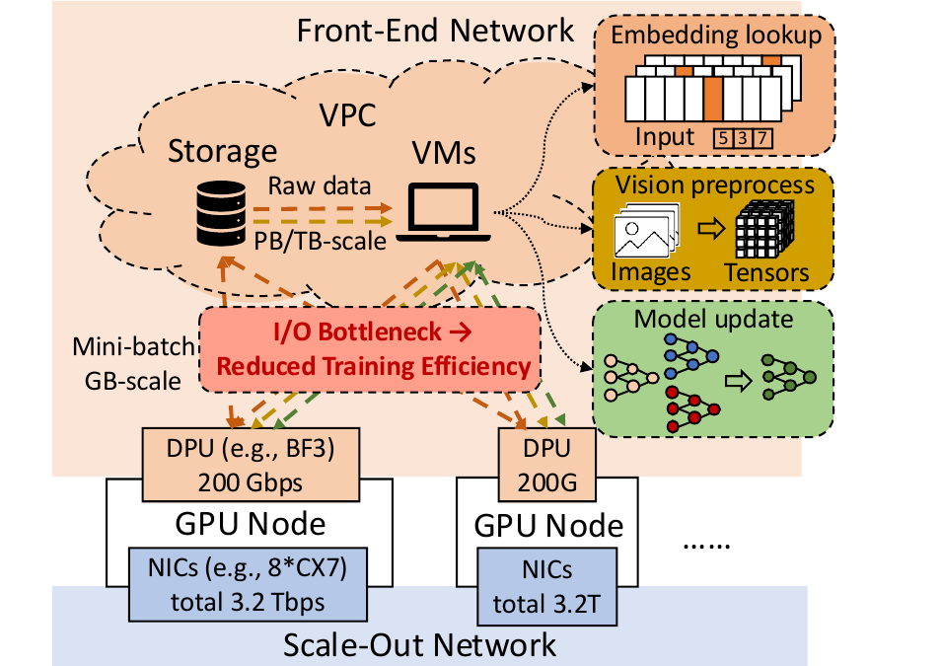
200 Gbps can bottleneck a 3.2 Tbps fabric
Bandwidth mismatch: 200 Gbps front-end DPU vs 3.2 Tbps aggregate NICs
The bottleneck appears wherever data crosses the VPC boundary
Recommendation models - embeddings
Multimodal training - raw data and preprocessing
Federated learning - frequent model updates
Long-context inference - KV-cache retrieval

Slide 4
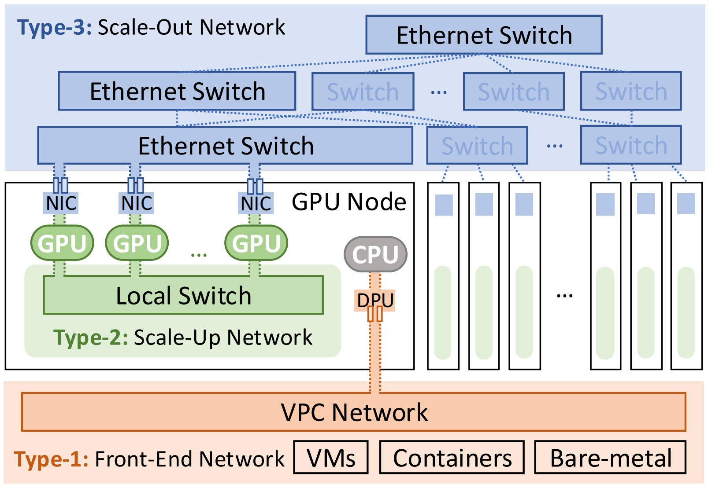
Connect the Back-End Network to the VPC
Current and Target Paths
Current path -- VPC traffic crosses the front-end DPU bottleneck
Target path -- carry VPC traffic over the scale-out network
vSwitch placement
  Back-end NICs -- insufficient compute, memory, and programmability for a full vSwitch
Host CPU -- consumes tenant resources and violates bare-metal isolation
Current Path
Target Path

Slide 5
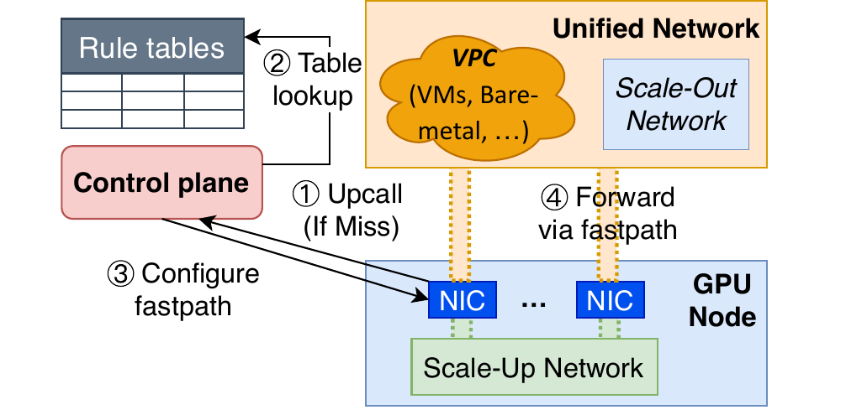
Decouple policy lookup from forwarding
Controllers
own global VPC rule tables and evaluates routing, ACL, and security-group policy
store a complete VPC engine
Steady-state traffic bypasses controller
back-end NICs
only store active match-action entries
a cache of active forwarding state
the slow path is bounded to misses, updates, and cleanup

Slide 6
Only the first packet takes the slow path
Upcall on miss
  NIC checks its hardware flow table
  An intermediary agent sends the the flow’s five-tuple to the controller
Table lookup
  The controller resolves VPC rules
Configure fast path
  writes a match-action entry.
Forward via fastpath
  Subsequent packets remain on the NIC fast path.

Slide 7
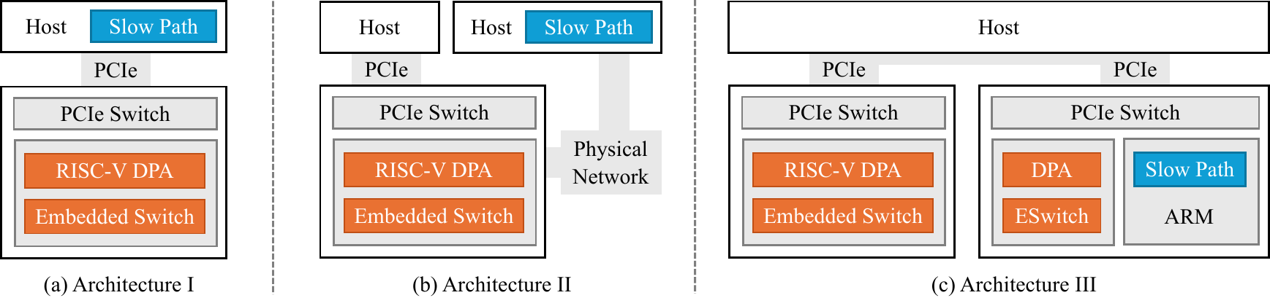

Local control, remote failover
Host CPU
Remote server CPU
Front-end DPU ARM
convenient
consumes tenant resources
violates bare-metal isolation
isolated
resilient
may increase latency
low-latency local control
A local DPU failure can affect downstream NICs
Preferred design: local DPU control in the common case, remote controller failover on failure.

Slide 8
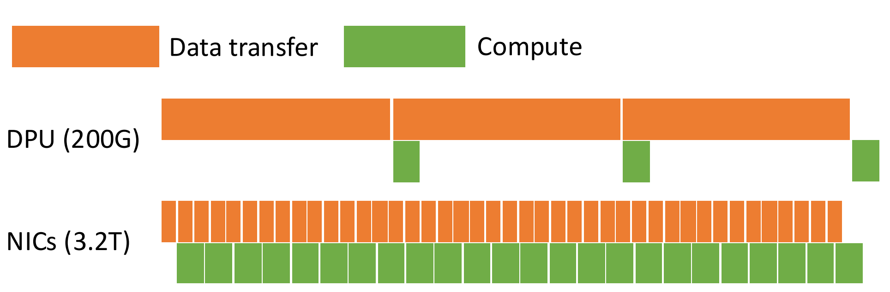
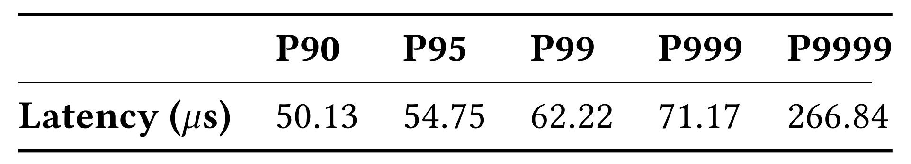
Performance Gains and First-Packet Cost
11.7% → ~100%
GPU utilization in the analytical model
8×
End-to-end throughput under identical modeled training settings
71.17 μs
P999 extra latency for rule installation
P9999 reaches 266.84 μs
long tail remains a deployment concern

Slide 9
Conclusion
Takeaway
Keep Complex VPC Policy off the NIC Fast Path
The controller performs complex policy lookup, while back-end NICs cache and execute active forwarding rules.
What the results support
Near-full modeled GPU utilization
8x modeled throughput
71.17 μs measured P999 rule-installation latency
Next steps
Production validation
controller scaling
stateful network functions

Slide 10

Integrating AI Clusters into Virtual Private Cloud
Yinhe Wang, Xing Li, Enge Song, Zihao Fan, Changgang Zheng, Haonan Li, Shengyao Gao, Juncheng Xiang, Ye Yang, Junnan Cai, Chang Liu, Haoxiang Pan, Yang Song, Yilong Lv, Qiang Fu, Zhigang Zong, Heng Pan, Shunmin Zhu
alibaba_cloud_network@alibaba-inc.com

